Slide 1

ISCG6420 JavaScript
Semester 1, 2017
Notes:
Use title slide layout

Slide 2
Document Object Model (DOM)
The DOM is an ‘application programming interface’
Use the DOM when we interact with web pages
Add content to an HTML document
Delete content from an HTML document
Change content on an HTML document

Slide 3
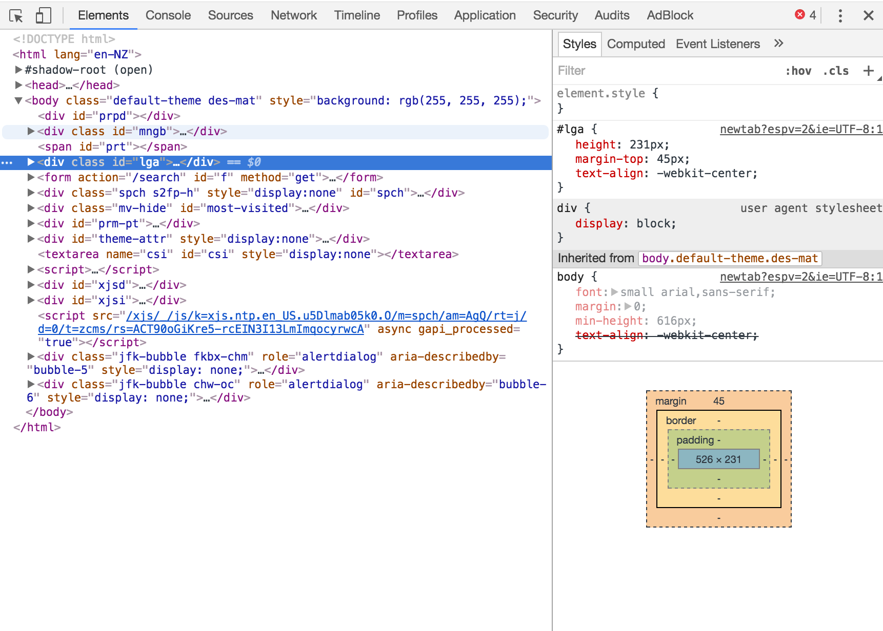
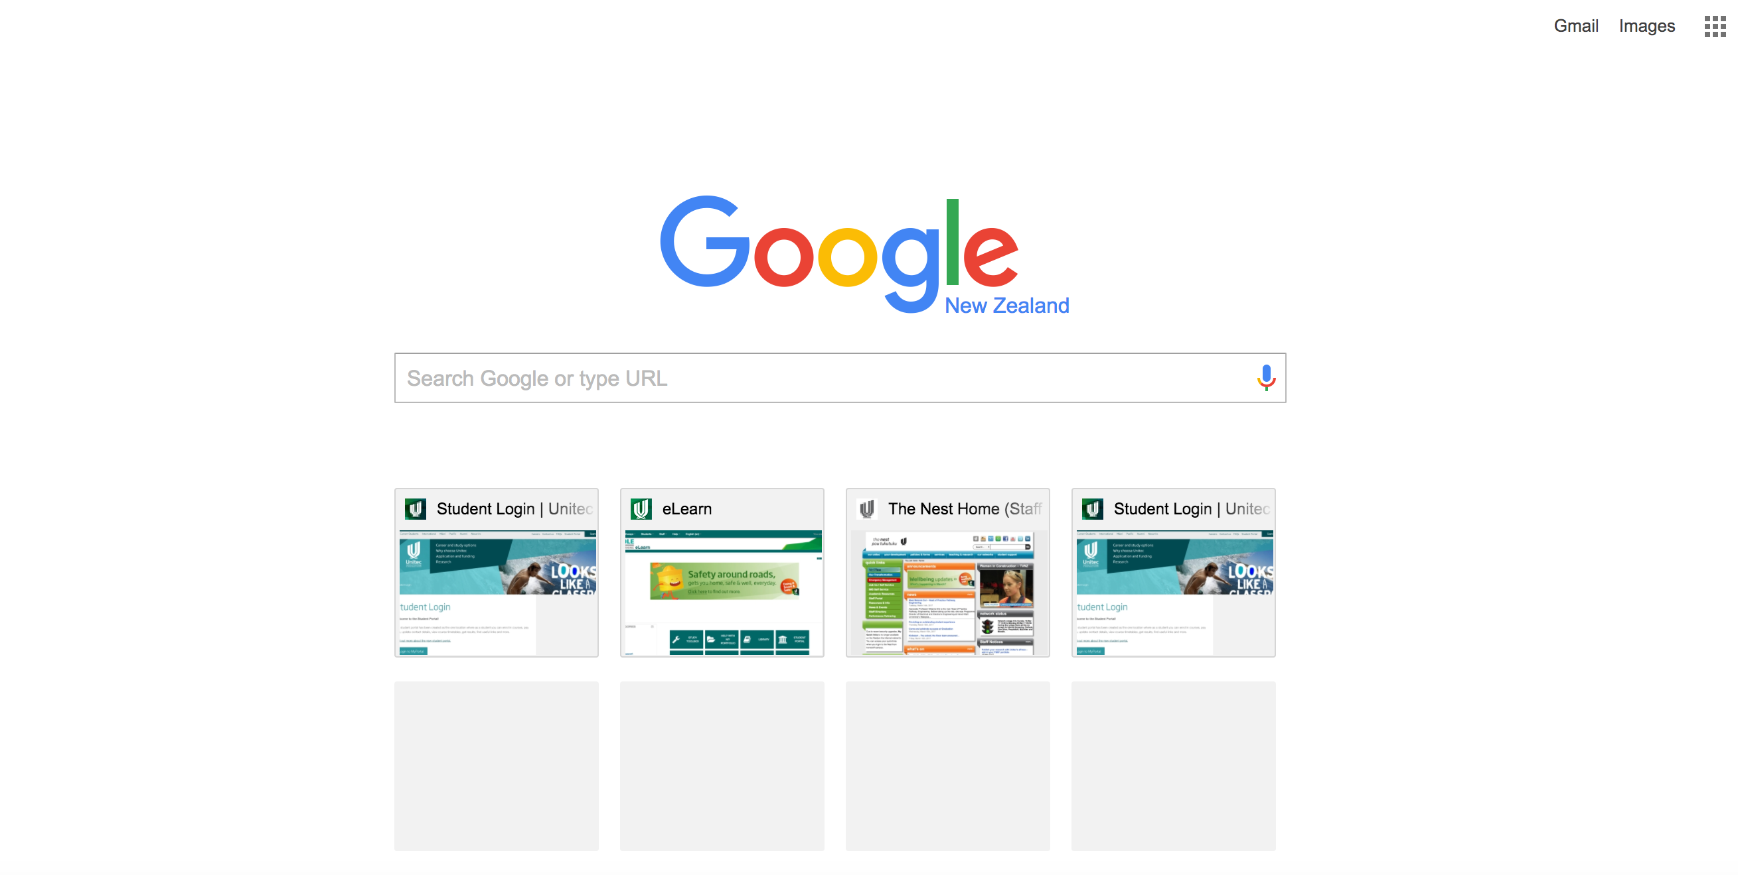
What is the DOCUMENT?
It’s a webpage

Slide 4
Objects are Elements
Every HTML element in the Document is an Object:
<head></head> is an object
<body></body> is an object
<li></li> is an object
<div></div> is an object

Slide 5
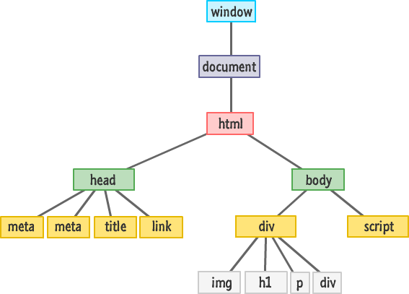
The MODEL
Essentially describes how objects are presented in a tree format (hierarchy)

Slide 6
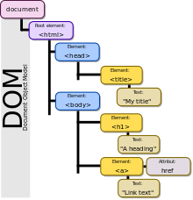
NODES
A node is everything we can change in a document for example:
Elements
Text within elements
HTML attributes

Slide 7
In the DOM, all HTML elements are defined as objects
The programming interface is the properties and methods of each object
A property is a value that you can get or set
A method is an action you can do

Slide 8
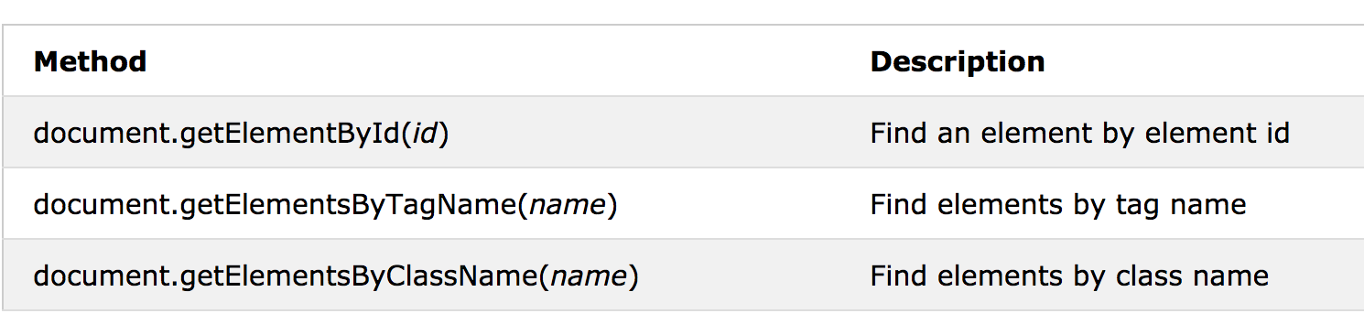
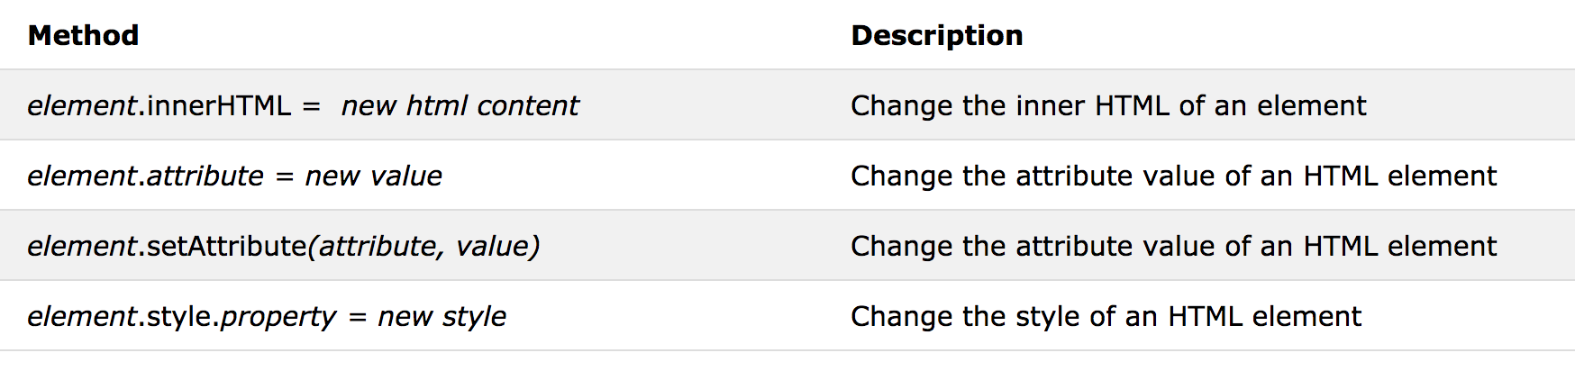
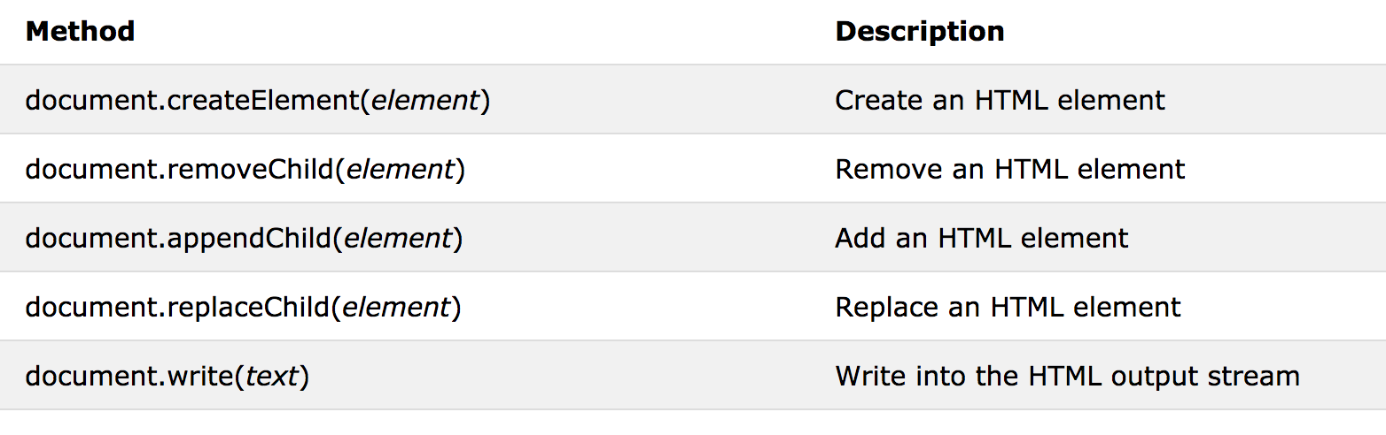

Slide 9
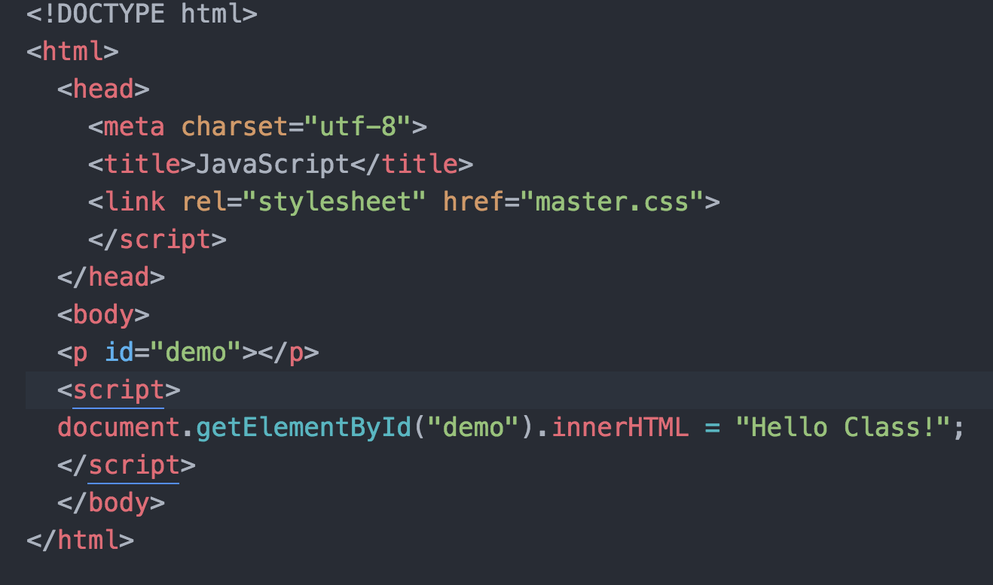

Slide 10
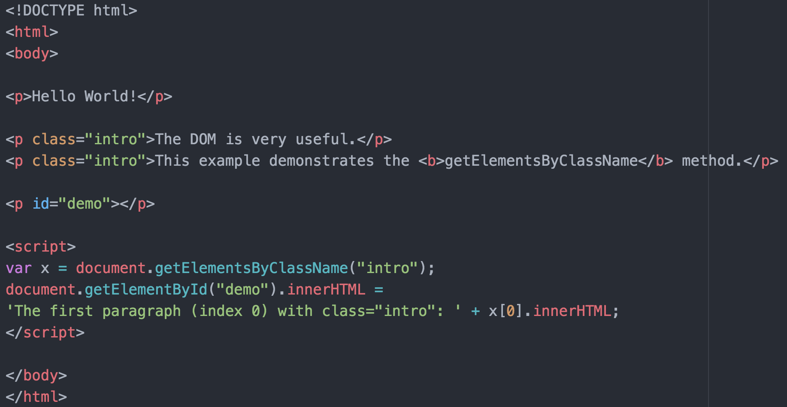

Slide 11
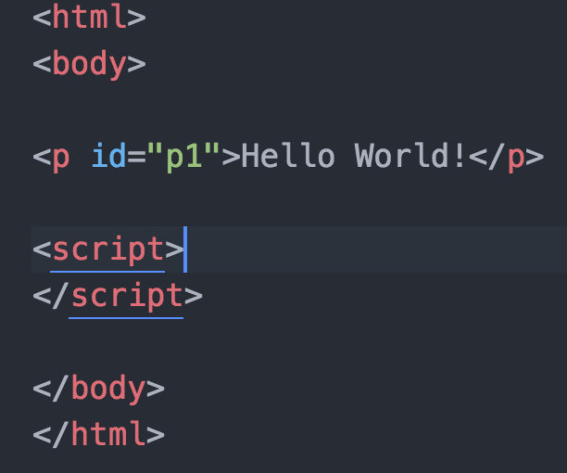

Changing HTML

Slide 12
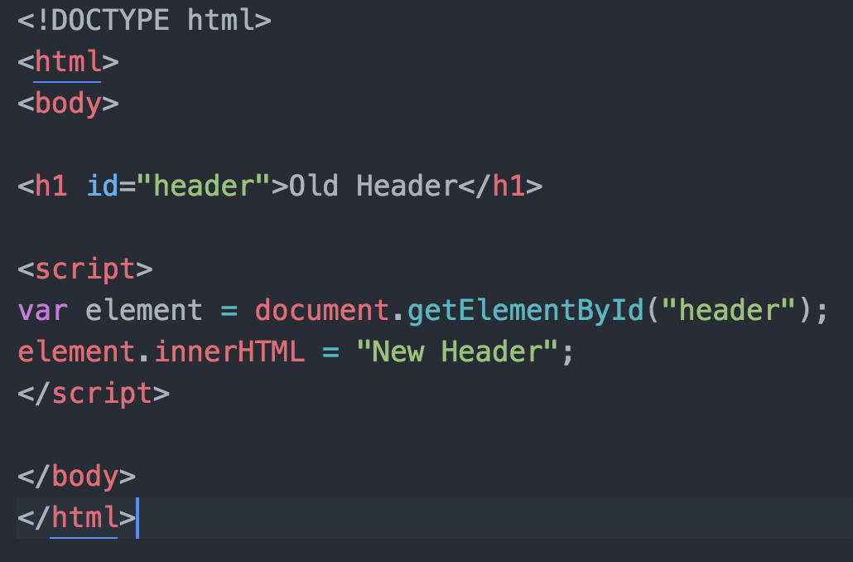

Slide 13
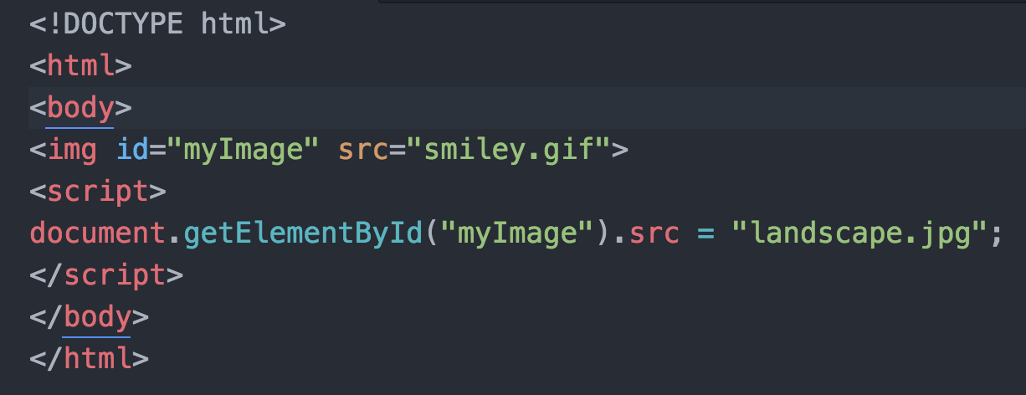
Changing values of the <img>

Slide 14
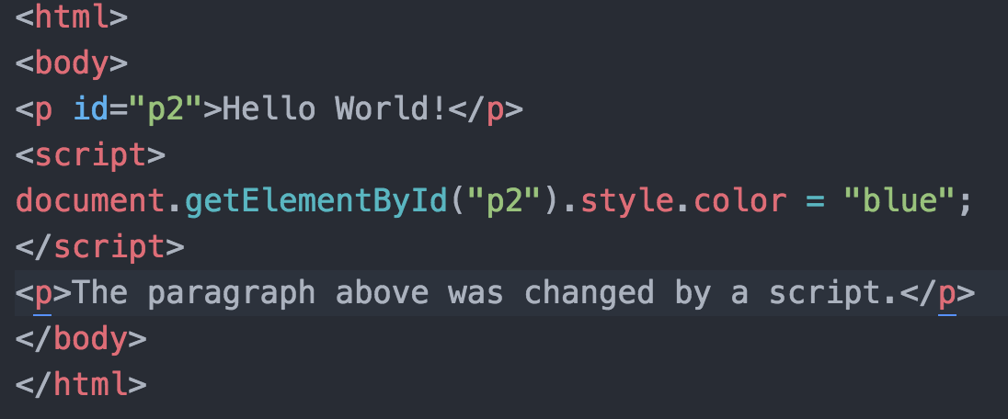
You can also change style values

Slide 15
Creating new HTML elements (Nodes)
A Node Interface is used to read and write the individual elements in the HTML node tree.
The childNodes property of an element node (including the documentElement) together with a loop construct can be used to enumerate each individual node for processing.
Main functions of the DOM API:
To traverse the node tree
To access and maybe change the nodes and their attribute values
To insert and delete nodes

Slide 16
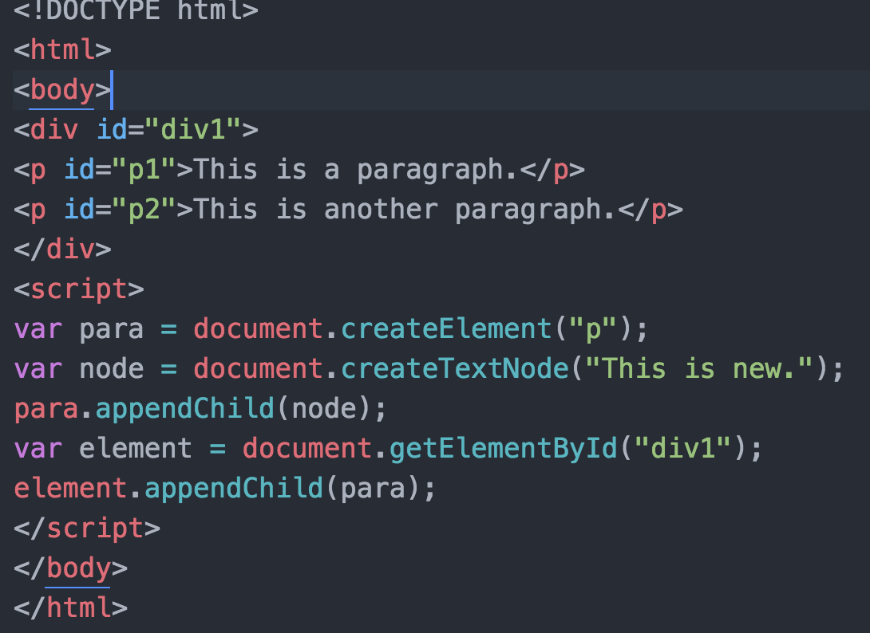

Slide 17
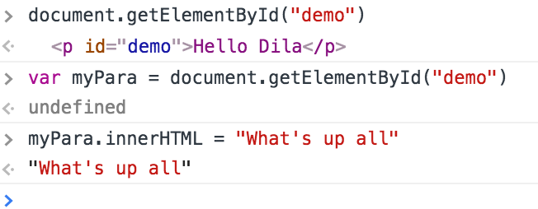

Slide 18
